Slide 1
Investment Appraisal

Slide 2
Time Value of Money (TVM)
The Time Value of Money is the concept that money available now is worth more than the same amount in the future, because it has the potential to earn interest or grow through investments. It is a fundamental principle in finance.
Key Terms:
Present Value (PV): The value of money today.
Future Value (FV): The value of money at a future date.
Interest Rate (r): The rate at which money can grow over time.
Periods (n): The time over which money grows (e.g., number of years).

Slide 3
Why Is Money Worth More Now?
If you have money today, you can invest it to earn interest or profit. If you get that same amount in the future, you miss the opportunity to earn interest or profit during the time you waited.

Slide 4

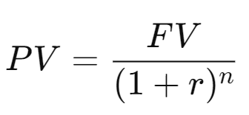
Formulas
Future Value (FV) of a present sum:
Present Value (PV) of a future sum:
​

Slide 5
Example: Simple Interest
Simple Interest is a method of calculating the interest charged or earned on a principal amount based on a fixed rate and time period
Example:
Suppose you invest $1,000 in a bank account that offers a 5% annual interest rate. At the end of one year, your money would grow as follows:

Slide 6

Example 1: Simple Interest
Suppose you invest $1,000 in a bank account that offers a 5% annual interest rate. At the end of one year, your money would grow as follows:
Notes:
Simple Interest (SI)=P×r×t

Slide 7
Example: Compound Interest
Compound interest means you earn interest on both the initial amount and any interest previously earned. Example: If you invest $1,000 at a 5% interest rate, compounded yearly, after 3 years you’ll have:

Slide 8

Example: Compound Interest
Compound interest means you earn interest on both the initial amount and any interest previously earned. Example: If you invest $1,000 at a 5% interest rate, compounded yearly, after 3 years you’ll have:

Slide 9
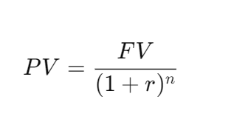
Present Value (PV)
The Present Value (PV) is the value of future money discounted to its worth today. It answers the question: How much do I need to invest today to have a specific amount in the future?

Slide 10
Present Value (PV)
You want $1,100 in 3 years, and the interest rate is 5%. How much should you invest today?

Slide 11
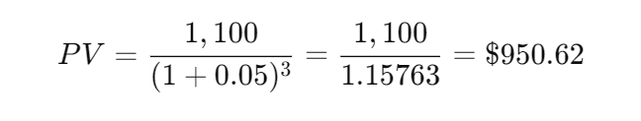
Present Value (PV)
You want $1,100 in 3 years, and the interest rate is 5%. How much should you invest today?
You would need to invest $950.62 today to have $1,100 in 3 years.

Slide 12
Discounted Cash Flow (DCF) Analysis
DCF Analysis is a method used to evaluate the viability of an investment by estimating future cash flows and discounting them to the present value using a discount rate
Cash Flow (CF): The amount of money coming in or going out from a project or investment.
Discount Rate (r): The rate used to discount future cash flows to present value (often the cost of capital or required rate of return).
Net Present Value (NPV): The total present value of future cash flows, minus the initial investment cost.

Slide 13
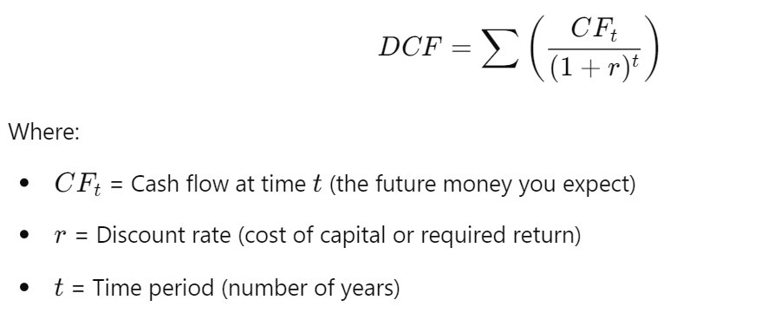
Discounted Cash Flow (DCF) Analysis

Slide 14
Example 4: Evaluating an Investment Using DCF
Let’s say you are evaluating a project that requires a $10,000 investment today. The project will generate $3,000 each year for 5 years, and the discount rate is 6%.

Slide 15
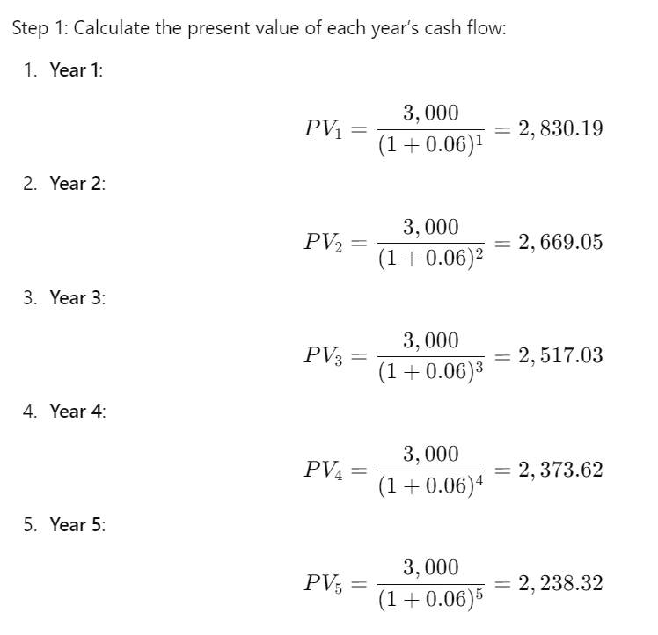

Slide 16
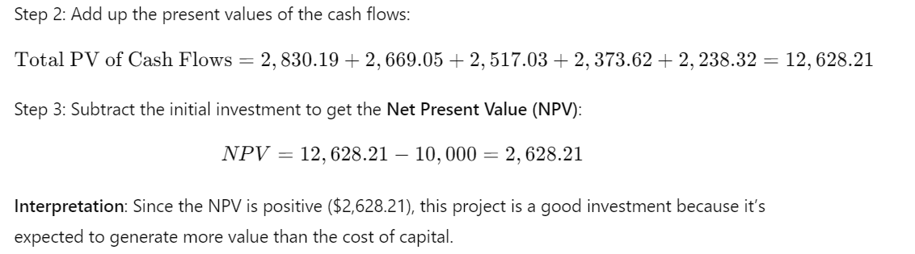
Example : Evaluating an Investment Using DCF

Slide 17
Interpreting a DCF Analysis in Commercial Terms
Positive NPV:
If the NPV is positive, it means the investment is expected to generate more value than the cost, making it profitable. This suggests the project will add value to the business or investor.
Negative NPV
If the NPV is negative, the investment is expected to generate less value than the cost, making it unprofitable. This means the project should likely be avoided.
Internal Rate of Return (IRR):
The IRR is the discount rate that makes the NPV zero. It represents the project’s expected return. If the IRR is higher than your required return (cost of capital), the project is worth pursuing.

Slide 18
Example : Commercial Decision-Making Using DCF
Let’s say your company is considering two projects:
Project A: Costs $15,000 today, generates $4,000 a year for 5 years.
Project B: Costs $20,000 today, generates $5,000 a year for 5 years.
Assume the discount rate is 7%.
After performing DCF analysis:
Project A’s NPV = $1,128.20 (positive)
Project B’s NPV = $830.40 (positive)
Both projects have positive NPVs, but Project A has a higher NPV. Therefore, in commercial terms, Project A is the better option, as it is expected to provide greater financial value to the company.

